Slide 1
VisionGuard AI – Privacy-Preserving Deidentification
Team name :- ASO AI TEAM
TEAM MEMBERS :- THAVISHI SPANDANA

Slide 2
THANK YOU
VisionGuard AI – Privacy-Preserving Deidentification
Email:spandanathavishi@gmail.com

Slide 3
Problem Statement
Sensitive data in healthcare, governance, and fintech documents often contains PII.
Traditional anonymization fails for semi-structured documents (forms, IDs).
Privacy breaches → compliance risks, loss of trust.

Slide 4
Proposed Solution
Open-source, modular AI pipeline.
OCR + NLP → Detect text-based PII (names, addresses, IDs).
Vision Layer → Detect faces, photos, signatures, stamps. Layout-Aware Models → Handle forms and ID layouts.
Redaction & Export → Mask/blur sensitive info, output redacted PDF.

Slide 5
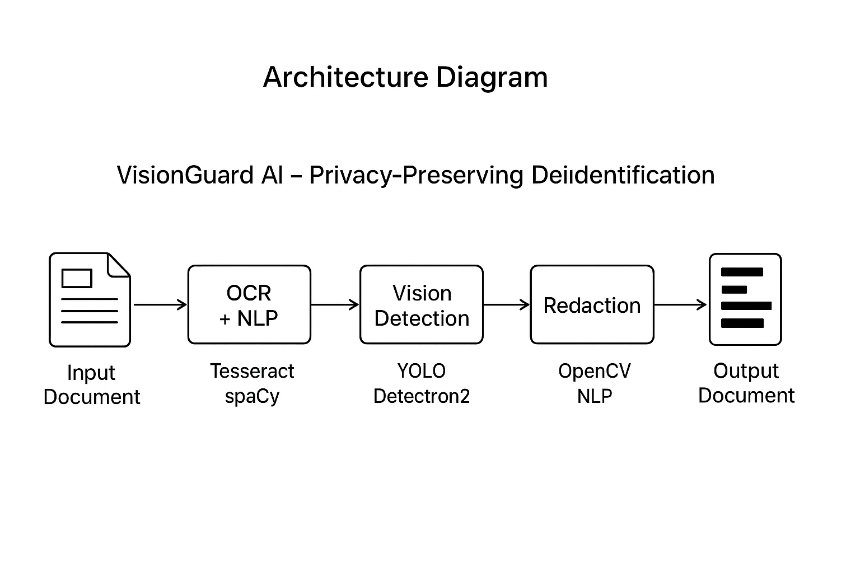
Architecture Diagram
Flow: Input Document → OCR + NLP → Vision Detection → Layout Understanding → Redaction & Export → Redacted Output.

Slide 6
Applications
Healthcare → Anonymize patient records for research.
Governance → Redact sensitive info from IDs, voter cards.
Fintech → Secure KYC & compliance documents.
Enterprise → Automate bulk document redaction.

Slide 7
Innovation & USP
Hybrid approach: Text + Vision + Layout.
CLI & REST API integration.
Open-source, scalable, easy-to-use.
Future roadmap: multilingual support, handwriting, dashboard.

Slide 8
Impact & Future Plans
Protects privacy while retaining data utility.
Enables compliance across industries.
Fosters a global community of responsible AI innovators.

